Slide 1
SEBA Master - Web Application Engineering
Exercise 1: Business Idea
Presented by: Team 52
Notes:
Welcome
Presentation of the results of first exercice

Slide 2
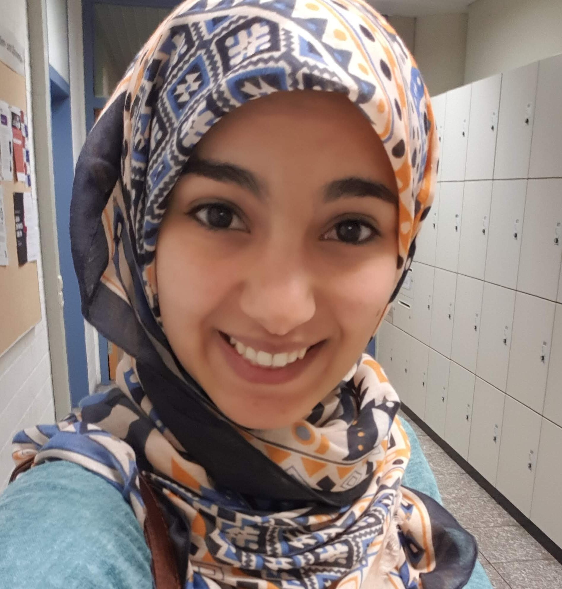
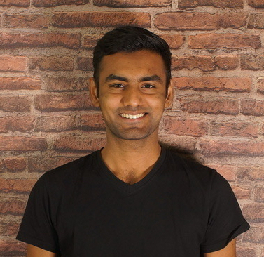
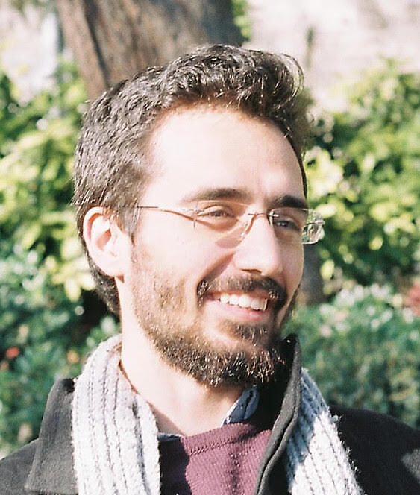
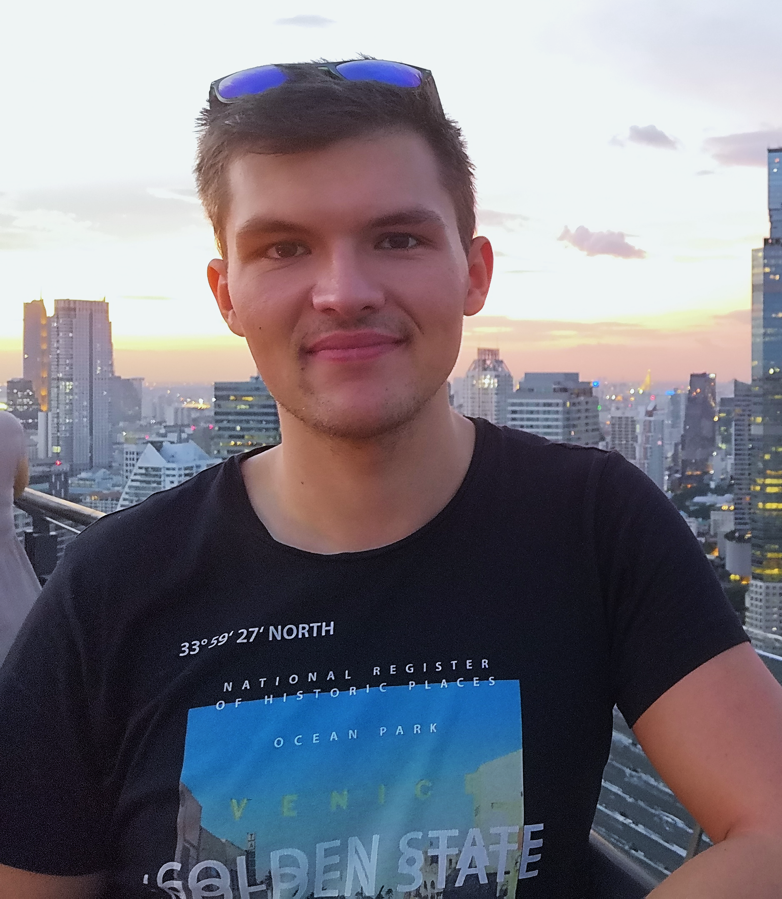
Team Introduction
Chatti Nada Master Informatics 2nd Semester
Rana Muhammad Fahad Master Informatics 3rd Semester
Yalcin Yasar Master Informatics 2nd Semester
Max Henneberg Master: Games Engineering 3rd Semester
Notes:
Our team consists of 4 master informatics students :

Slide 3

Business Idea
Price of a group ticket per person is way cheaper then a ticket for one single person
Our idea: Web application where one can publish a group ticket and share the price with people that are interested in the same activity.
e.g : public transport, festivals, events…
 | 26 €
 | 17 €
 | 14 €
 | 12,5 €
 | 11,6 €
Bavaria Ticket price / person
Notes:
Often the price of group tickets per person is way cheaper then a ticket for one single person
Here we have the example of Bavaria ticket
Our idea: Web application where one can publish a group ticket and share the price with people that are interested in the same activity.

Slide 4


Customer Segment
Customer
Relationship
Value Propositions
For All Customers (except Retail)
Save Money
Safe Payment/ Usage Environment
Sozialising
Public Transport Users
-
Travelers/Spare Time Activity Goers
Suggestion for Events
Ticket Retailers
New User Segments
Safe Payment Environment
User Segments
Public Transport Users
Young People
People interested in saving Money
People bored by long journeys alone
Travelers
Spare Time Activity Goers
Festival
Concerts
Amusement-Park
People interested in Meeting new Friends
Ticket Retailers
Least Intrusive
App as Middleman
Customer Support
Safe Environment
Channels
Application
Website
Mobile Application (Future Plan)
Customer Reach
Social Media
Network Based Marketing
Notes:
Customer Segment
Click: User Segment
(Stress difference Between Normal EndUsers and Ticket Retailers
Retailers are not the first Target Group. Focuse on “normal” Endusers first to Build user Base
Click: Value Propositions:
Explain For All Customers Counts for all Except Reailers
Click: Channels
Channel: Our Application (Delivers Product to Customer)
Channel: Channels we gonna use to Increase Userbase
Customer Relationship:
Webpage as a Middleman
No Interference except if user need support
Most Important Customer Segment: Travlers/SpareTime, because of highest expected revenue (because prob. Easier collab with Ticket Retailers than public transport providers)

Slide 5



Keys to Success
Key Partners
Partners
Event Companies
Hotels
Holiday Management Companies
Beta Testing Partners
Resources by Partners
Offers/Tickets
API for Bookings
Commissions
Testing
Suppliers
Ticket Information Websites
End Users
Resources by Suppliers
Information about Events/ Tickets
Tickets
Key Activities
Building the Product
Intuitive/Fast UI
Escrow Payment System
Building Userbase
Provide base supply of Tickets (Contact Ticket Retailers)
Marketing Strategy
Key Resources
Reliable Server Hardware
Safe Storage for personal Data (esp. Payment Information)
Tickets
Marketing Agency (grow Userbase)
Support Team (provide safe environment)
Notes:
Keys to Success:
Key Partners:
Partners: Working Together to profit from each other
Suppliers: We rely on them to provide us with Ticket/Ticket Information
Key Resources
Hardware
Resources we need to sell and maintain safe env.
Key Activities (Two Important Factors)
Building Product = Important for MVP
Building Userbase: Fast growing Userbase (concept only works with enough users)

Slide 6

BMC
Keys to Success
Customer Segment
Cost Structure
Revenue Streams
Immediate
Free App (increase Userbase)
Advertisements
Promoted Offers (by Retailers)
Smart Advertisements
Hotels
Car Rental
Future Income
Cooperation with Ticket Retailers
Special Offers
Margin for Tickets
Sell App
Standing Costs
Initial Development Costs
Marketing to Build User Base
Running Costs
Maintance Costs (Bug Fixing, new Features)
Hosting Costs (Scale with Userbase)
After Launch Marketing
Support Team
Notes:
Final Components of our BMC
Click: Already Talked about Keys to Success and Customer Segment
Bad Things First: Cost Structures
Standing Costs
Running Costs (remark the scaling factor of Hosting and Support Team)
Good Things After: Revenue Streams
Immediate
Future Plans
Explain: Sell App (Like Paypal)
Next Slide: Our BMC as Endslide

Slide 7
Customer
Relationship
Key Partners
Partners
Event Companies
Hotels
Holiday Management Companies
Beta Testing Partners
Resources by Partners
Offers/Tickets
API for Bookings
Commissions
Testing
Suppliers
Ticket Information Websites
End Users
Resources by Suppliers
Information about Events/ Tickets
Key Activities
Building the Product
Intuitive/Fast UI
Escrow Payment System
Building Userbase
Provide base supply of Tickets (Contact Ticket Retailers)
Marketing Strategy
Value Propositions
For All Customers (except Retail)
Save Money
Safe Payment/ Usage Environment
Sozialising
Public Transport Users
-
Travelers/Spare Time Activity Goers
Suggestion for Events
Ticket Retailers
New User Segments
Safe Payment Environment
User Segments
Public Transport Users
Young People
People interested in saving Money
People bored by long journeys alone
Travelers
Spare Time Activity Goers
Festival
Concerts
Amusement-Park
People interested in Meeting new Friends
Ticket Retailers
Least Intrusive
App as Middleman
Customer Support
Safe Environment
Channels
Key Resources
Reliable Server Hardware
Safe Storage for personal Data (esp. Payment Information)
Tickets
Marketing Agency (grow Userbase)
Support Team (provide safe environment)
Application
Website
Mobile Application (Future Plan)
Customer Reach
Social Media
Network Based Marketing
Cost Structure
Revenue Streams
Standing Costs
Initial Development Costs
Marketing to Build User Base
Running Costs
Maintance Costs (Bug Fixing, new Features)
Hosting Costs (Scale with Userbase)
After Launch Marketing
Support Team
Immediate
Free App (increase Userbase)
Advertisements
Promoted Offers (by Retailers)
Smart Advertisements
Hotels in Region of Event
Car Rental
Future Income
Cooperation with Ticket Retailers
Special Offers
Margin for Tickets sold through our Plattform
Sell App if enough big enough Customerbase is reached
Notes:
Time for Questions

